Slide 1
York County American Relief Funds Dredge Justification
October 20, 2021

Slide 2
$ 1.8 million for Infrastructure/Dredge Purchase Justification
Multi-community dredge needs in York County
$$ Revenue Impact: Beach Improvement directly benefits all coastal communities, as well as inland community beach enjoyment, employment
Dredge Equipment Purchase Only: No County commitment required to operate and employ for dredge
Direct County Government Action on Climate Change
Eliminates capital costs of dredge onto individual communities
Barnstable County, Cape Cod provides the template for future County/ Regional governance

Slide 3
York County Dredge Need
Most of Maine sand beaches are located in York and Cumberland Counties
All Maine sand beaches are eroding and require replenishment
Dry beach availability is an important economic/tourist attraction factor for Southern Maine (more than $500 million annually for York County alone)
45% Maine visitors go to beaches
Army Corps is not reliable for harbor dredging -schedule – 20 year scheduled dredge in Saco took 20 years to occur
Army Corps does not do beach replenishment except as part of a harbor dredge

Slide 4
Maine Beach Erosion Issues
York County
Cumberland County
York
Seapoint
Cresant
Ogunquit
Wells
Laudham
Drake’s Island
Wells
Kennebunkport
Goose Rocks
Biddeford
Hills
Kennebunk
Goochs
Parsons
Cresant & Surf
Saco
Camp Ellis
Ferry Beach & State Park
Old Orchard
Ocean Park/Goosefare
West Grand
Scarborough
Higgins
Scarborough
Ferry-Western
Pine Point
East Grand
Cape Elizabeth
Cresant
Kettle Cove
South Portland
Willard

Slide 5
Maine Federal Navigation Channels
Municipality | Last 2 Dredges | Services | Last Dredge Cu Yds.
Saco | 1992 / 2015 | 4 private marinas, public marina, 3 boat ramps, public pier, more than 200 commercial/recreational vessels | 67,000
Kennebunkport | 1975 / 2018 | 50 commercial & 30 recreational vessels | 4,132
Kennebunk | 2014 / 2016 | 68 moorings, 18 commercial, 12 charter, 200 – 300 recreational vessels | 3,200
Wells | 2014 / 2018 | 25 commercial, 15 charter, 150 recreational vessels | 12,620
Ogunquit | 1976 / 1994 | 74 moorings, 26 commercial, 6 charter, 200 recreational vessels | 16,100
Kittery | 2000 / 2012 | Pepperell Cove – 39 commercial, 6 charter, 200 recreational vessels | 14,323
Scarborough | 2013 / 2015 | 50-60 moorings, 25-30 commercial, 15 seasonal charter vessels | 116,325

Slide 6
York County Coastal Community Economic Impact
York County/Beaches contribute more than $500 million annually to Maine Summer Tourist Revenue
York County Summer Tax Revenue by Year:
Year | Winter (N,D,J,F) | Summer (J,J,A,S) | Tourist Revenue
2019 - 2020 | $ 541,394,000 | $ 805,177,000 | $ 283,738,000
2018 - 2019 | $ 456,739,000 | $ 963,378,000 | $ 506,639,000
2017 - 2018 | $ 520,119,000 | $1,048,589,000 | $ 528,470,000
2016 - 2017 | $ 488,739,000 | $ 963,378,000 | $ 506,639,000
2015 - 2016 | $ 421,694,000 | $ 906,941,000 | $ 485,247,000
COVID
Data from Maine Economist website – Kittery, Kennebunk, Biddeford ESA

Slide 7
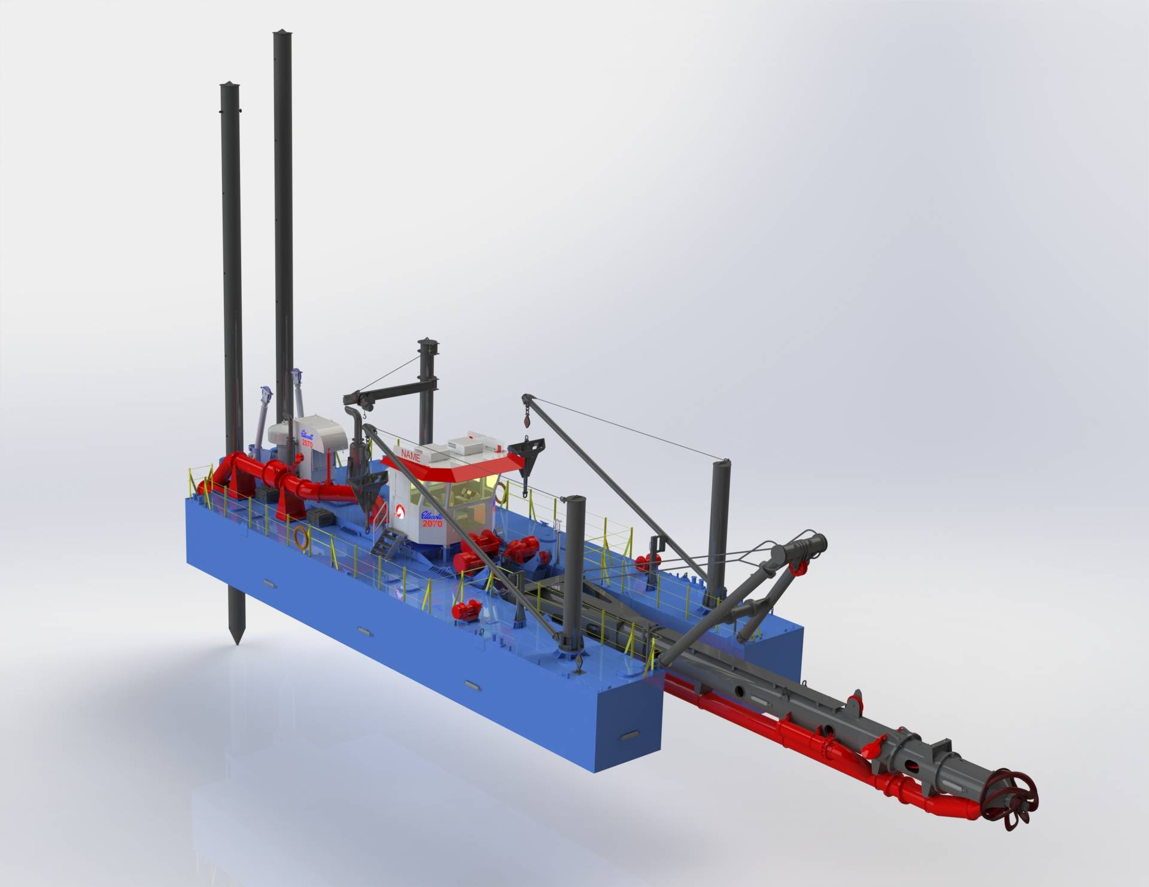
Ellicott 670 Dragon Suction Dredge

Slide 8
Ellicott 670 Dragon
Dredge In Stock Now -- Cost $1,516,000
Shipping $50,000, Support Boat $234,000
Successfully Used in Barnstable County (> 10 years)
Averages 10 projects in 168 days
Average Operations budget -$ 706,000 (not requested from York County, see proposed regional commission plan in packet)
Dredged Material cost – Averages 47% below market

Slide 9
Ellicott Quote (pg 1 of 2)
 |  | Ellicott 670 "DRAGON" Series Cutter Suction Dredge | $1,415,000
 | Tier 3 | per listed specifications, Ex Works Ellicott factory.
 |  | Standard Features included with Dredge:
 |  | Hull of three piece steel construction
 |  | 14" suction pipe with fittings
 |  | 14" discharge pipe
 | 121980 | 14" flap valve
 |  | 42' digging depth
 |  | 100 HP cutter module
 |  | Caterpillar C18 engine
 |  | Size 43 6-blade cutter
 |  | Independent winch operated ladder hoist system
 |  | Two independent hydraulic swing winches
 |  | Cog belt driven hard iron dredge pump
 |  | Safety equipment including aluminum handrails,
 |  | 3 life vests, 2 life rings and 2 fire extinguishers
 |  | Two sets of instruction manuals and parts books
 |  | Cutter Selection (Choose):
 | 134304 | Size 43 six-blade plain edge basket cutter
 | 115255 | Size 43 six-blade renewable edge tooth cutter
x | 115245 | Size 43 six-blade renewable plain edge cutter
 | 118584 | Size 43 six-blade serrated edge cutter

Slide 10
Ellicott Quote (pg 2 of 2)
 | 143858 | Zinc Anode Installation for Pontoons | $1,833
 | 144072 | Crane, Stern Jib | $5,667
 | 143723 | Crane, Pump Handling | $11,667
 | 109289 | 500 lb. Danforth anchors and one set | $4,417
 |  | of wire ropes including clips and thimbles
 | 148753 | Air conditioner/heater | $9,492
 | 154648 | Signal, Navigational Mast Installed | $11,655
 |  | Dredge Positioning System includes Dredgepack | $37,329
 |  | Software, Hardware and Installation Only
 |  | Training & Travel Expenses Not Included
 |  | Services (Field Engineering):
 |  | Technical support for supervision of assembly, start-up,
 |  | and crew training (including field service travel and
 |  | living expenses) included for a period of five (5) days.
 |  | Enhanced training program | $7,500
 |  | Extra days available at $1,200 per calendar day plus
 |  | expenses.
 |  | Total Dredge & Options (items 1 through 3) | $1,515,922
 |  | Estimated Sales Tax (based on your location)
 |  | Estimated Shipping (based on your location) | $50,000
 |  | Support Boat (if not contracted in local area) | $234,078
 |  | Total Funding Request | $1,800,000

Slide 11
Operational Costs (NOT being asked from County*)
Dredge Supervisor $ 100,000
Dredge Captain 75,000
Dredge Leverman 65,000
Maintenance Engineer 65,000
Dredge Deckhands 100,000
$ 430,000
Ancillary
Maintenance $ 100,000
Insurance 25,000
Fuel ($3/gal) 151,000
$276,000
*See Regional Commission Proposal in Packet. Data from SMPDC 2018 Report-Included in Packet

Slide 12
Summary
Direct County impact upon economy & climate change with < 5% of York County $40m allocation
Infrastructure purchase only & proper category for ARF use
Dredging performed tourist offseason Nov 15 to April 15 (151 days) due to migrating species- off season – shared among municipalities
Dredge rates 38% to 68% below market from dredge ownership
Accommodates small and large projects – up to 10 projects per year
And please note:
Operational concerns and discussions are ongoing, but really cannot be resolved until funding is found for the dredge equipment. Options include a private company, a host community; plus the county as Administrator
York County Government dredge purchase makes a bold and important step, at $0 local cost, in action for tourism, jobs and saving our shoreline environment.
Data source: SMPDC- Examining the Feasibility of Purchasing and Operating Hydraulic Dredging Equipment in Southern Maine, July 2018, Attached in Packet

